Slide 1
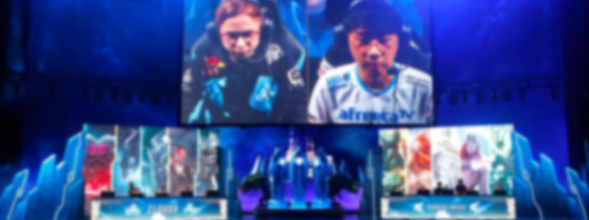

eSports Analytics: League of Legends Optimization

Slide 2
Table of Content
Data Set- League of Legends
Business Case
Purpose
Process
Results
Win/Objectives Rates
Ban Rates
Predictions Models
Conclusions
Questions

Slide 3
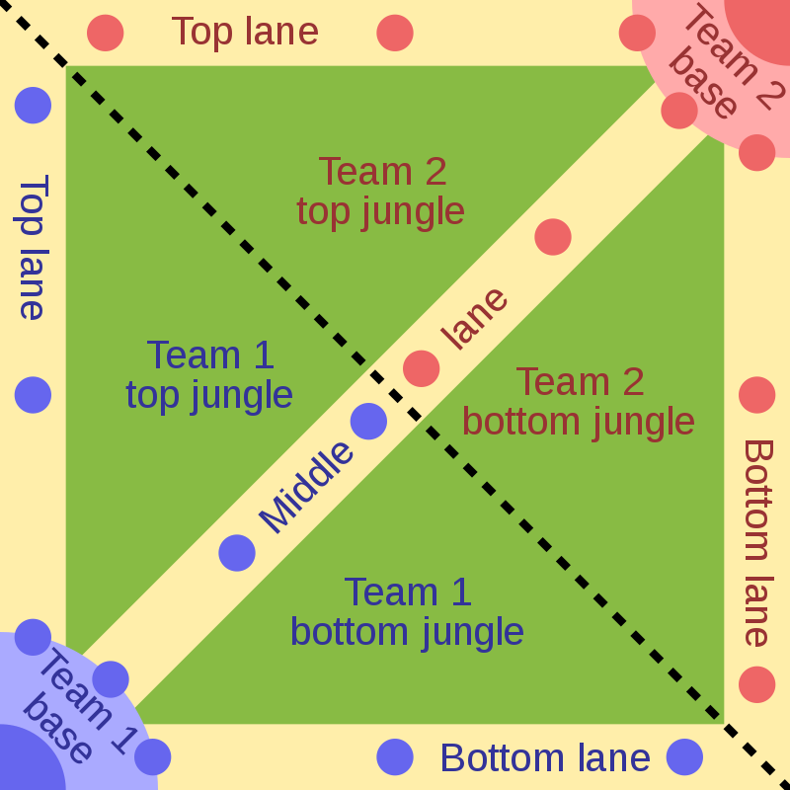
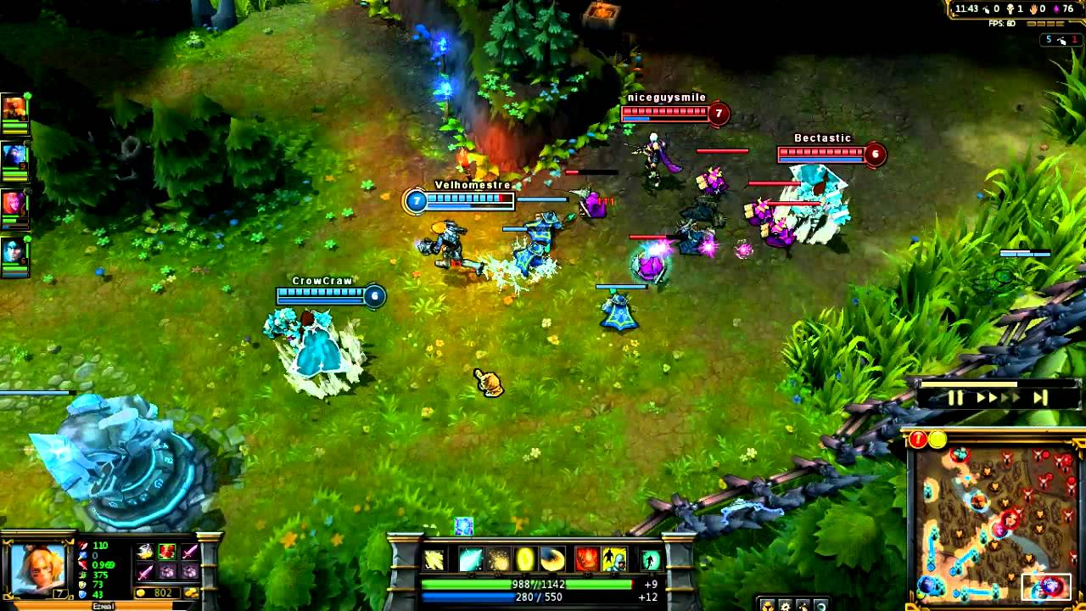
Data Set – League of Legends
League of Legends
PC MOBA (Multiplayer online battle arena) Game
2 Teams (5 Players/Team) Try To Destroy Other Base
Side Objectives
Typically Game Play 20-60 minutes
Structure of Data
~ 3MB of Data
Over 50,000 Ranked Games
CSV & JSON Files
61 Variables
Binary, Factor, Numerical, Char

Slide 4
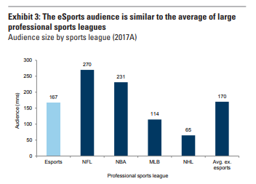
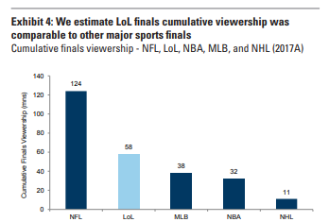
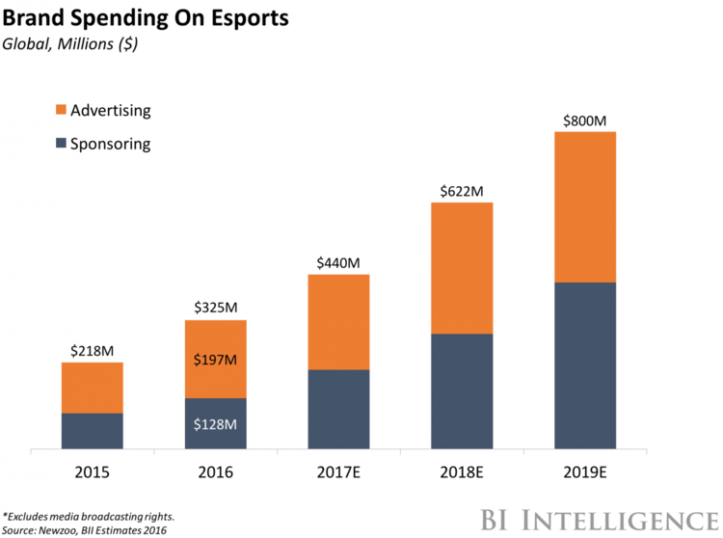
Business Case
LOL One of Top 5 Competitive Games
Soon to be 1B Dollar Industry (3 years)
VCs Have Started Investing
Multiple Companies Involved
Other Analytics Companies in
this Market (EEDAR)
Financial Participation From
Competitors and Spectators,
Sources:
https://www.goldmansachs.com/insights/pages/infographics/e-sports/report.pdf
https://www.businessinsider.com/esports-market-growth-ready-for-mainstream-2017-3

Slide 5

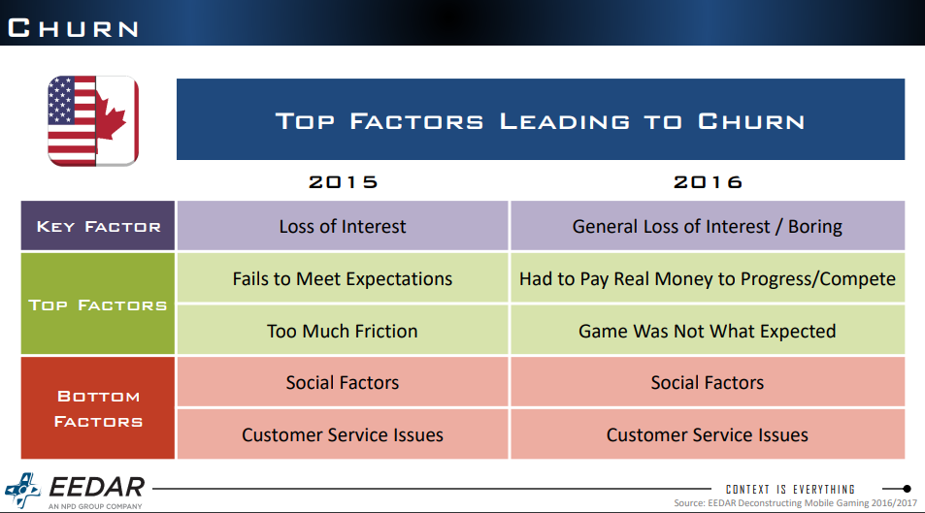
Purpose
Identify Most Successful Teams and Situations for:
Recruitment
Strategy – Offensive
Strategy – Defensive
Club Management
Created 16 Business Questions to Answer Overall Question
Win Rates
Kill Rates
Side Objective Rates
Team Compositions
Etc.

Slide 6
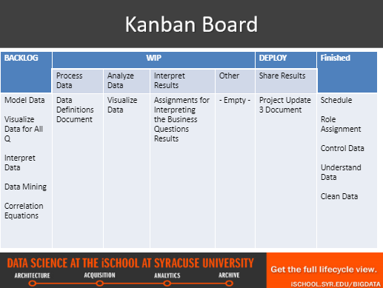
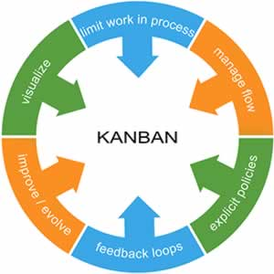
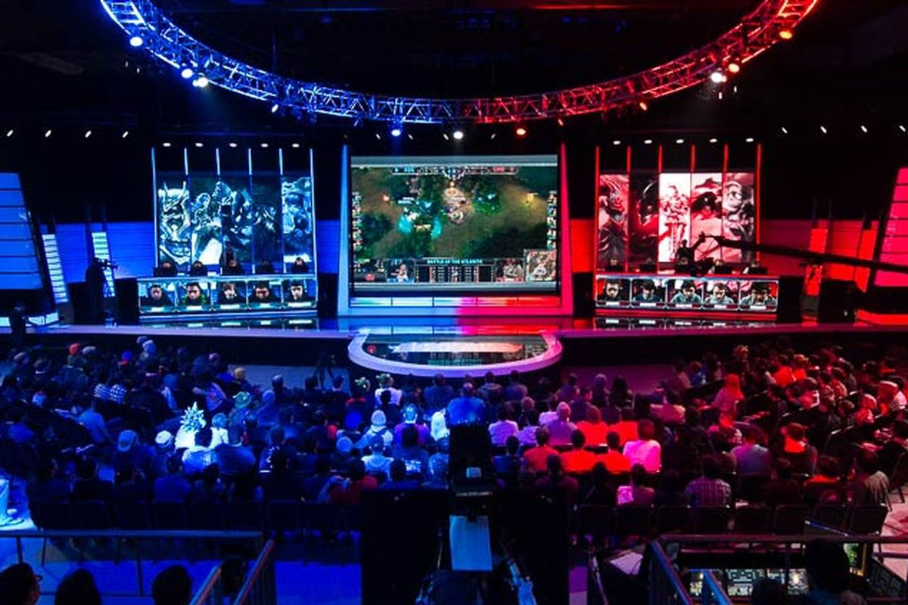
Process
Kanban Planning Methodology (4 cycles)
RStudio development (2525 Lines of code)
Team Assignments (Outside R development)
Tanbir – Project Lead
Ning – Technical Lead
Rashad – User Experience Lead
Graham – Documentation Lead

Slide 7
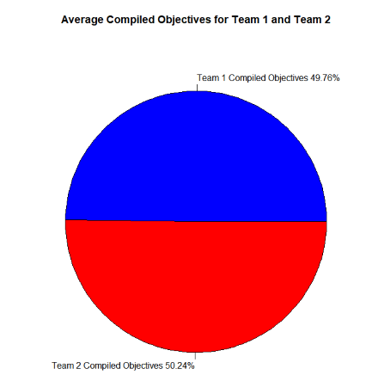
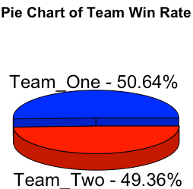
Results – Wins/Objectives Rates

Slide 8
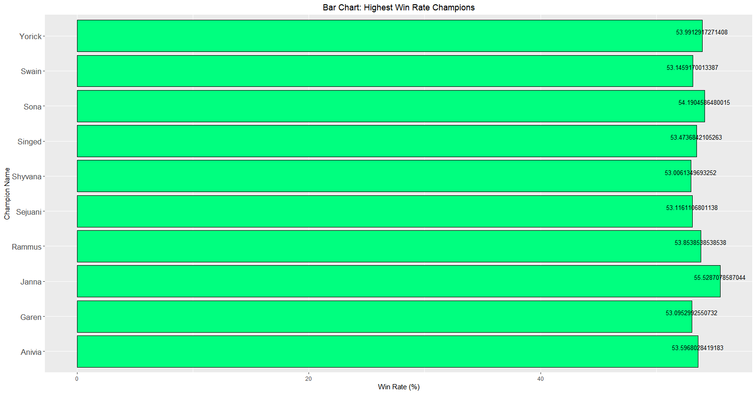
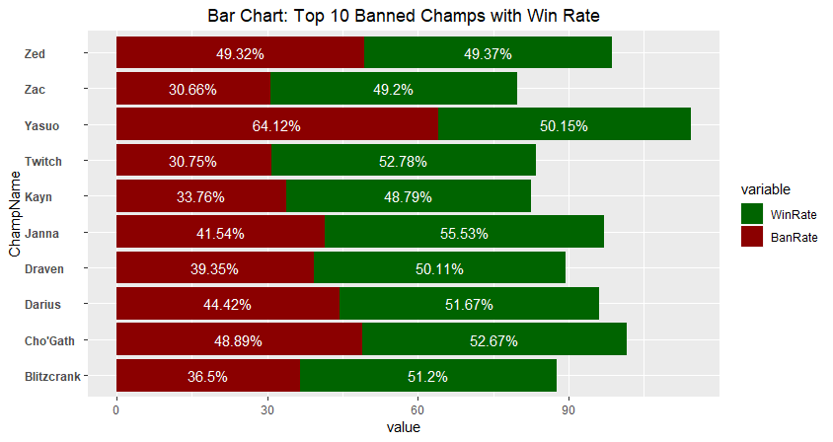
Results – Ban Rates/Win Rates

Slide 9
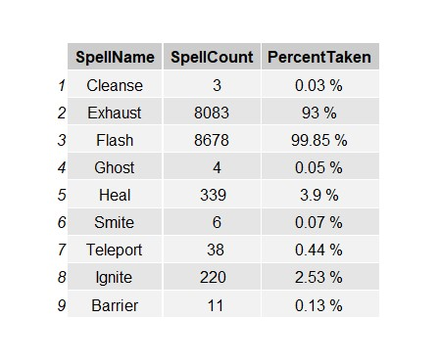
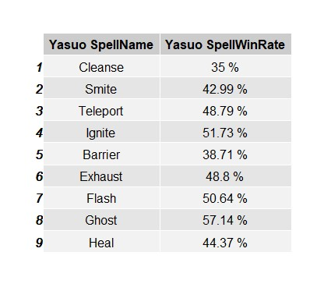
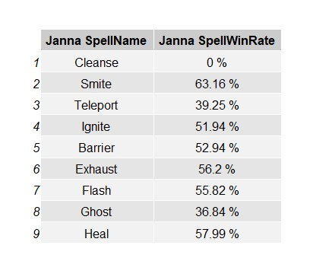
Results – Top Spells

Slide 10
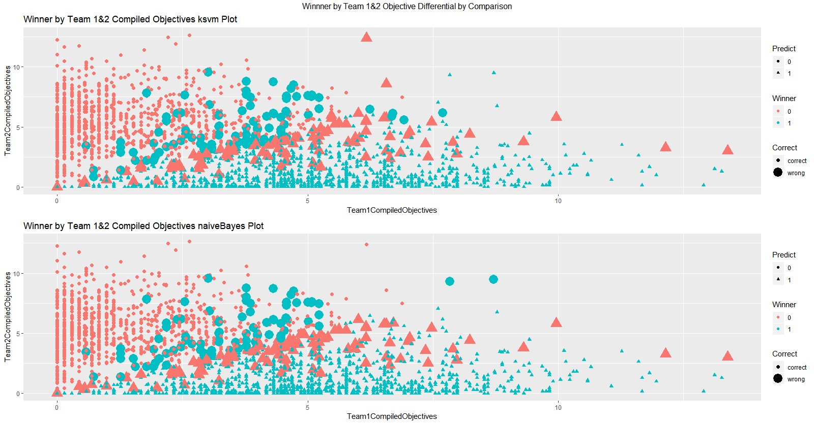
Results - Prediction Models
Figure: Model Comparison - Accuracy to predict the Winner based on Team 1 & 2 Compiled Objectives

Slide 11
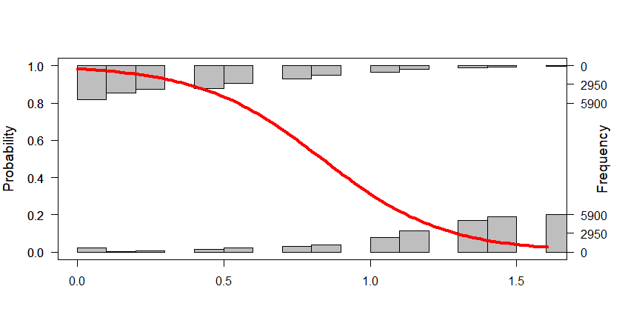
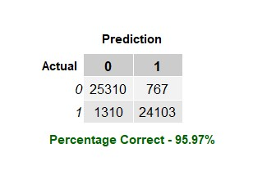
Results - Prediction Models
Figure: Probability of Winning Team as Demonstrated by t1_towerkills

Slide 12
Conclusions
Champions
Janna wins the most and Ryze wins the least.
Thresh is the best counter to Janna.
Yasuo is the most banned champion.
Teams
The win percentages of both teams is near to a 50/50 split, and on average, both teams have the similar objective totals.
Team 1 composition with the most objectives is Taric, Katarina, Lee Sin, Xayah, and Kayle.
Team 2 composition with the most objectives is Lucian, Master Yi, Twitch, Morgana, and Trundle.
Strategy
The best combination is the champion Janna with the summoner spells Flash and Exhaust.
A tower kill is the most significant measure to determine which team will win a match.
A Rift Herald is not significant in determining an outcome of match. Potential re-work of this mechanic may be needed to increase its impact.
Adjustments need to be made to address certain champion and summoner spell combinations.
Given the objectives of both teams, an accurate prediction can be made to determine the outcome of a match. However, it is difficult to determine an outcome when the objectives per team are equal.

Slide 13
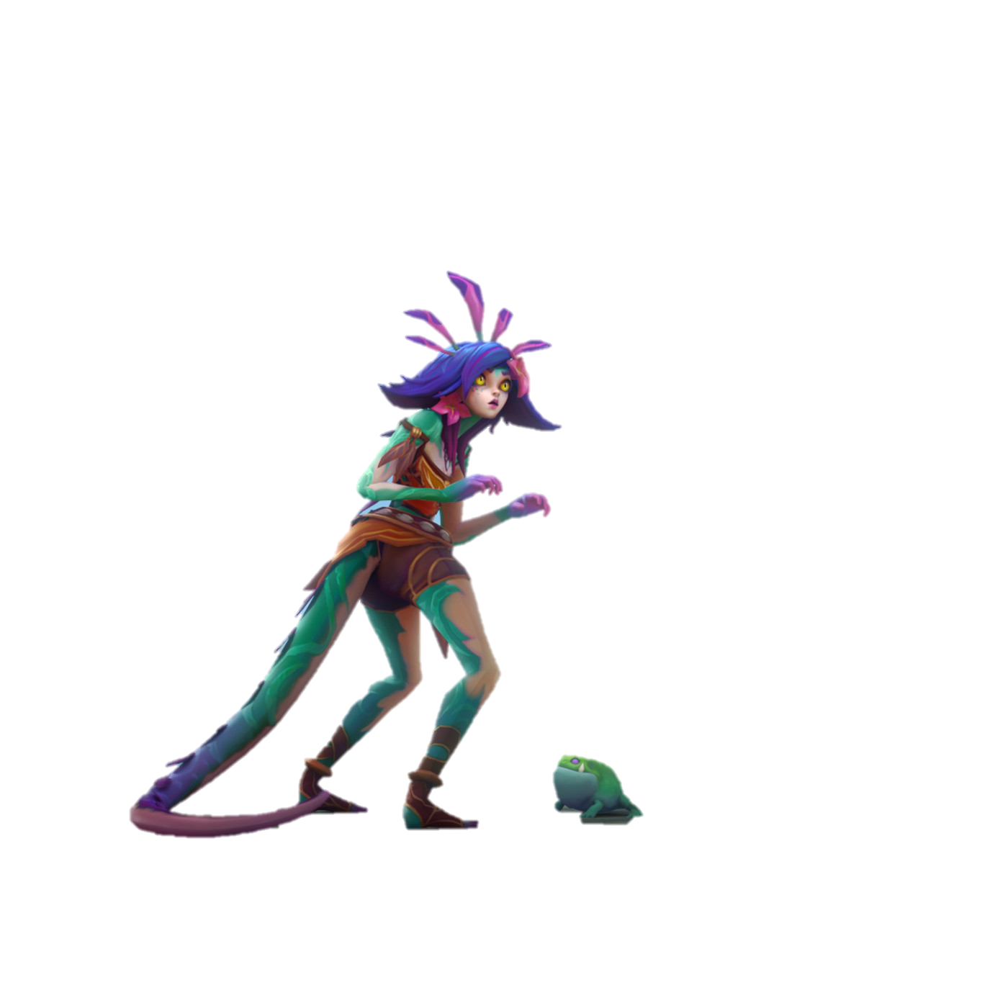
Questions?
?

